Slide 1
Milestones Math review

Slide 2
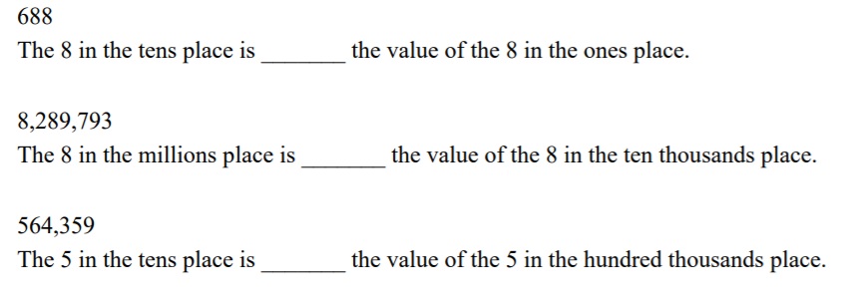
Powers of ten
40,000_______= 400
5x10,000 =________

Slide 3
properties

Slide 4
Properties

Slide 5
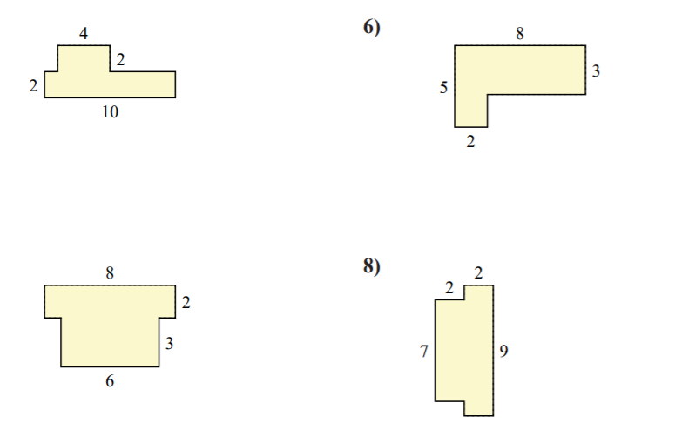
Find the area and perimeter of these figures

Slide 6
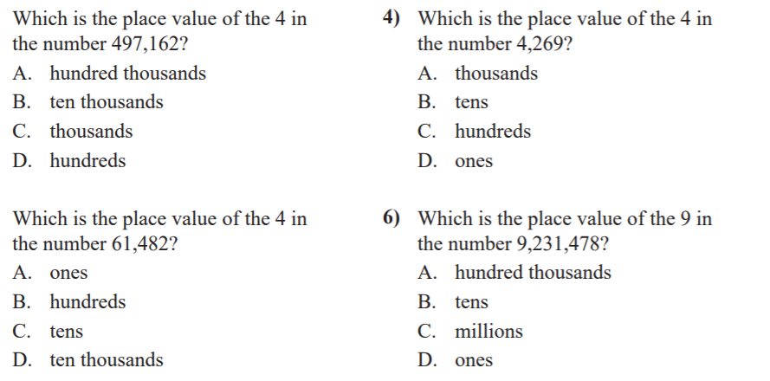
Place value
Write the numbers below in word form, and expanded form
395,023
67,112
100,005

Slide 7
Factors/multiples
List all factors of 48
List the first 5 multiples of 7
List the factor pairs for 16

Slide 8
Multiplicative comparisons
48 is _____ times as many as 8.
18 is 2 times as many as _____.
2 times as many as 2 is _____.
24 is _____ times as many as 8.
At the carnival there were eighteen people in line at the roller coaster which is three times as many as were in line at the Ferris Wheel. How many people were at the Ferris Wheel?
Faye had eight times as many dollars as her sister. Faye has seventy-two dollars. How much money does her sister have?

Slide 9
Multiplication/division
3681x5
45x67
12x30
79x38
9803/4
725/5
1000/3
4608/2

Slide 10
fractions
Simplify these fractions:
4/12
22/100
11 5/10
33/36
Find two equilavent fractions:
3/6
7/18
10/100

Slide 11
Comparing fractions
Compare each pair:
4/6 and 3/9
½ and ¼
2/8 and 12/16
Order the fractions from smallest to largest
¾, ½, 5/6
12/24, 6/10, ¼
23/23, 14/28, 10/100

Slide 12
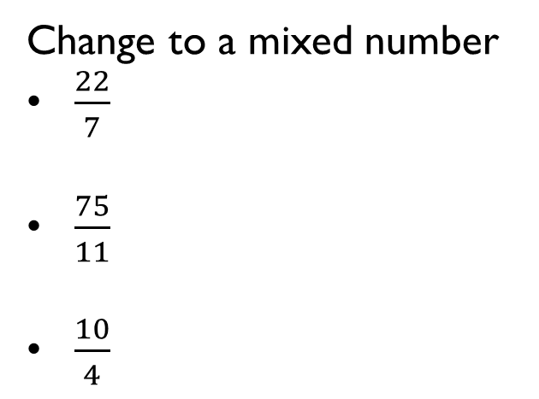
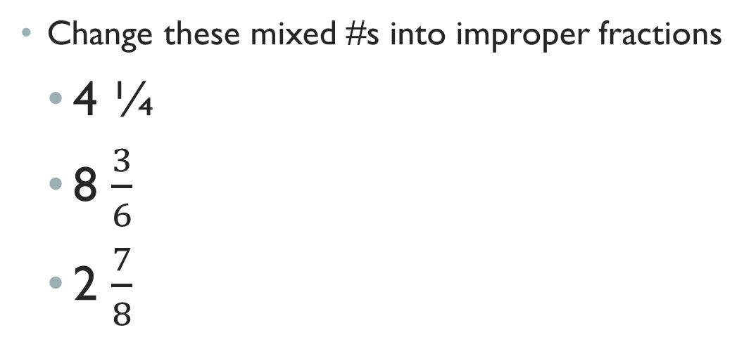
Mixed #/improper fractions
Change these mixed #s into improper fractions
4 ¼
8 $\frac{3}{6}$
2 $\frac{7}{8}$
Change to a mixed number
$\frac{22}{7}$
$\frac{75}{11}$
$\frac{10}{4}$

Slide 13
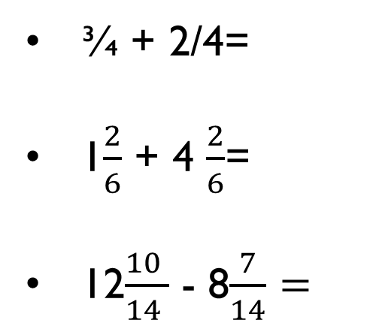
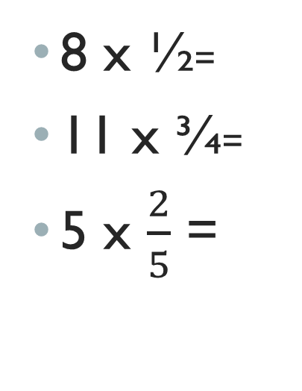
More fractions
8 x ½=
11 x ¾=
5 x $\frac{2}{5}$ =
¾ + 2/4=
1$\frac{2}{6}$ + 4 $\frac{2}{6}$=
12$\frac{10 }{14 }$ - 8$\frac{7}{14}=$
Fill in the missing number
5 = ___
10 100
20 = 2__
100

Slide 14
decimals
Write the fraction for each decimal
0.4
0.25
0.07
0.10
0.045
Write the decimal for each fraction:
½
10/100
3/100
8/10

Slide 15
Geometry
Draw:
a line segment
A ray
A line
Right angle
Obtuse angle
Straight angle
Acute angle
Quadrilateral
Trapezoid
pentagon
Parallel lines
Perpendicular lines
A shape with a line of symmetry
Intersecting lines

Slide 16
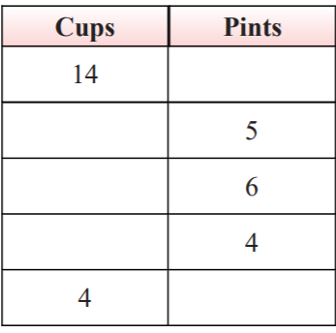
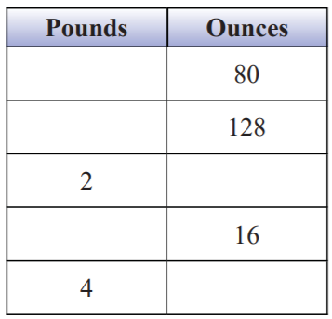
measurement
6 feet = ___ inches
____ feet = 24 inches
5 yards = ___ feet
___ yards = 24 feet

